Slide 1


Shared Applications
Jason Bell (jason.bell@arcs.org.au)
Lev Lafayette (lev.lafayette@arcs.org.au)
Padric McGee (padric.mcgee@arcs.org.au)
Ashley Wright (ashley.wright@arcs.org.au)
Supported by:

Slide 2
Session Details
Shared Presentation
Shared Browser
VenueVNC
TigerBoard
Shared Desktop
Shared Themo
Shared Rasmol
ParaView

Slide 3
Shared Presentation
How to start a Shared Presentation
Uploading data
Taking control
Known issues
  Avoid using Slide Transitions
  Slides not staying in Sync
    Forced to load to a particular slide number
    Use the “Sync” option

Slide 4
Shared Presentation (Hands on)
Create a Shared Presentation
Rename Shared App
Take Control as Master
Change slides
Change presentations

Slide 5
Shared Browser
How to start a Shared Browser
Changing web-pages
Known issues:
  If you scroll down a web page, others don’t see the scrolling
  Text highlighting doesn’t work
  Mouse pointer isn’t shown

Slide 6
VenueVNC
What you see, is what everyone else sees!
Known issues:
  More than 5-7 connections, things start to slow down
  Firewall limits use at many institutions
Supposedly, TightVNC runs better than RealVNC for multiple connections
Would like to investigate the use of a VNC Reflector

Slide 7
AGTigerboard
Features:
  Can be used as an AG Shared App, or stand alone
  Can use to show PowerPoint presentations
  Allows the drawing on presentations and has a built in pointer
  Allows you to take screen shots and upload the image
Comes with the all in one (Windows) installer
Project listing - http://www.accessgrid.org/project/TigerboarAG

Slide 8
Shared Desktop
Software developed by Todd Zimmerman of Simon Fraser University, as part of the WestGrid computing project (www.westgrid.ca)
The SharedDesktop Access Grid shared application listens for other SharedDesktop users to share their desktop via VNC - then offers them to the user
http://www.accessgrid.org/project/shareddesktop
http://old.westgrid.ca/collabvis/research/projects/ace/shareddesktop.php

Slide 9
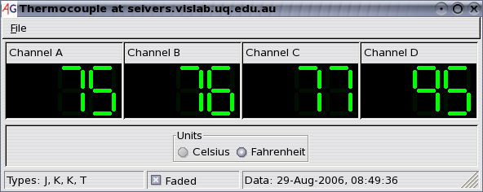
Shared Thermo
This AG's shared application, which is an example of remote sensor monitoring, shares live sensor data with other participants.
The sensor data consists of temperature outputs from four thermocouples attached to a Weeder Technologies WTTCI-M thermocouple input module, which is connected to a computer via its RS-232 port.
http://www.vislab.uq.edu.au/research/accessgrid/software/instruments/

Slide 10
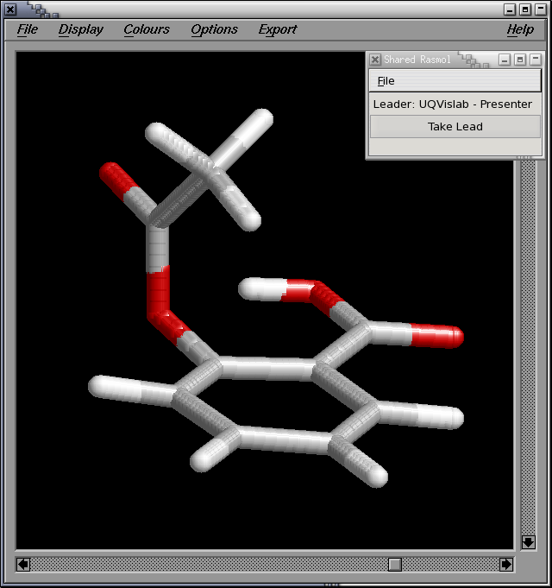
Shared Rasmol
RasMol is a widely used program for molecular graphics visualisation
Thomas Uram of Argonne National Laboratory created a Shared Application version of Rasmol version 2.7.1.1 for use in the Access Grid
Some enhancements have been implemented at University of Queensland Vislab by Stephane Bidet
http://www.vislab.uq.edu.au/research/accessgrid/software/rasmol/

Slide 11
ParaView
Thomas Uram of Argonne National Laboratory created a Shared Application version of ParaView
ParaView is a widely used visualization application
  Cluster-based rendering
  Remote data server
As visualization workflows often involve visualization experts and domain science experts, there’s a strong use case for shared visualization
Contains a Venue Client Plug-in
Uses VPMedia to stream visualization

Slide 12
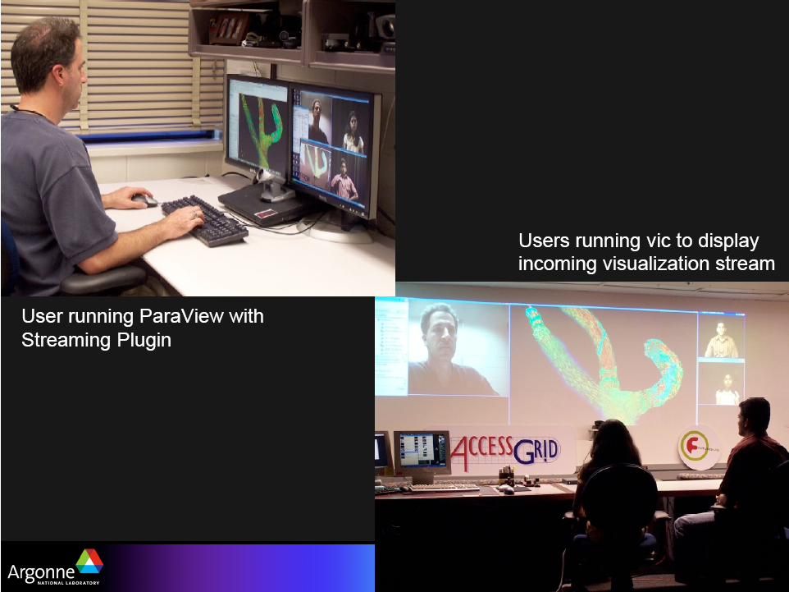
ParaView
Image taken from “Collaborative Visualization with ParaView” Presentation, Tom Uram, AG-Retreat, 2008.

Slide 13
Acknowledgements
Doug Kosovic and Chris Willing (UQ) for previous work on presentation material

Slide 14
Questions???

